Slide 1






North South University
QUIZE
https://github.com/md-yasir-arafat/Online-Quiz-Application

Slide 2

INTRODUCTION
Quize is a multiplayer quiz app. This app is for students to compete against each other by enrolling in various different courses and attending quizzes which are published by teachers.

Slide 3
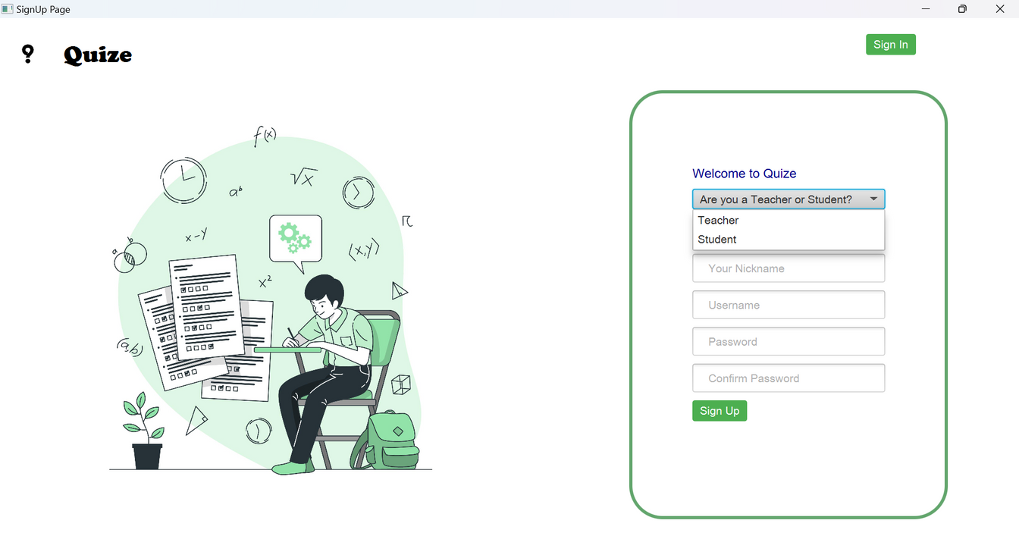
SIGNUP CLASS
User Input Validation: Ensures valid input during the sign-up process, including handling special characters for CSV compatibility.
Credential Storage: Saves user credentials (username, password, full name, etc.) in role-specific files (Teacher/Student).
File Management: Creates necessary directories and files for user data if they don't already exist.
UI Setup: Initializes and configures UI components such as buttons, combo boxes, text fields, and images.
Seamless Sign-Up: Manages the sign-up process, handling user input and triggering the sign-up logic while closing the sign-up window after completion.

Slide 4
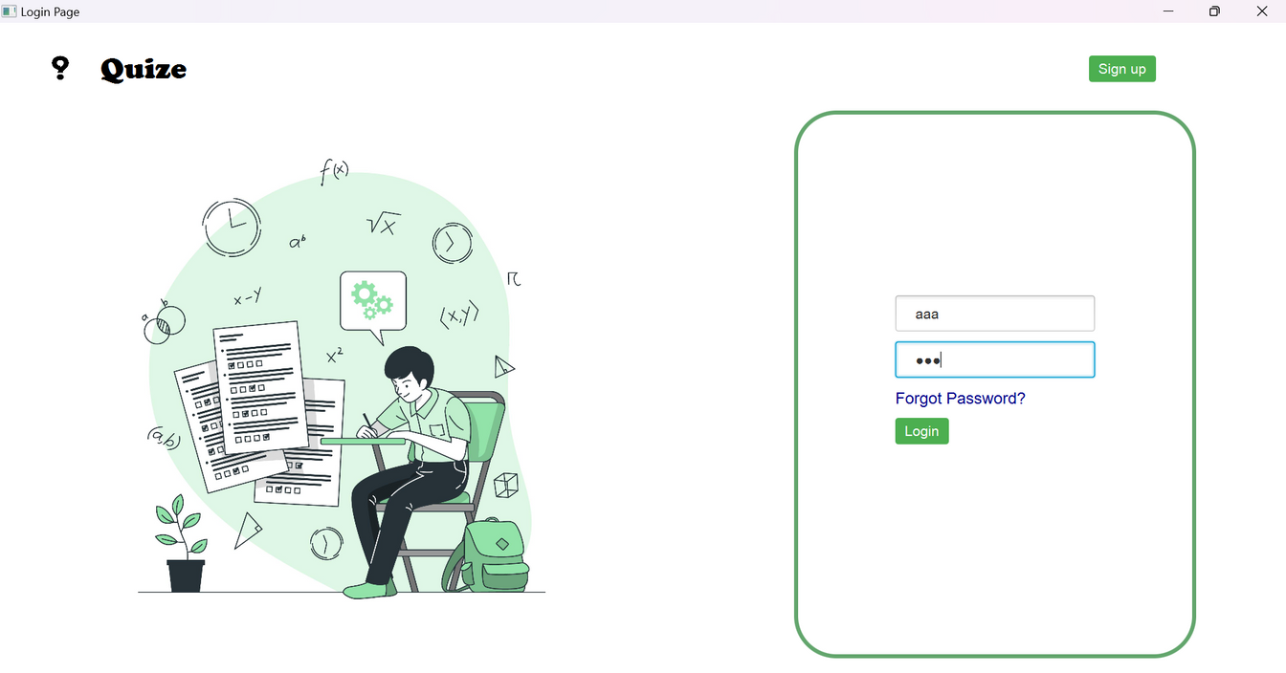
LOGIN CLASS
Seamless login process: Integrates backend login functionality with a visually appealing UI from LoginPageUI.fxml.
Credential verification: Validates user credentials to ensure secure access.
Role-based navigation: Redirects users to appropriate sections based on their roles.
User-friendly interface: Provides an intuitive and accessible login experience.
Efficient integration: Combines login logic and UI design for a smooth user experience.

Slide 5
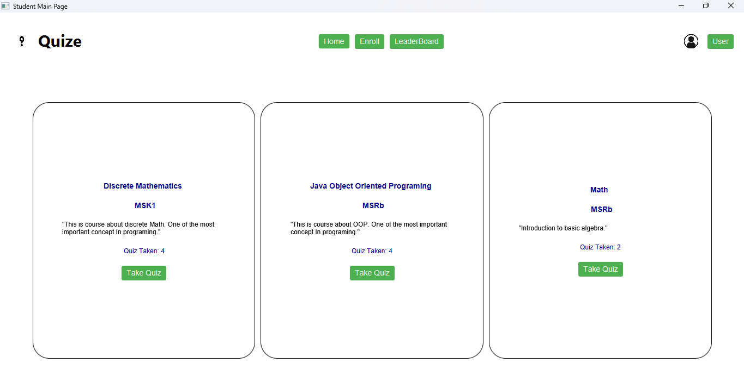
STUDENT MAIN CLASS
Course Management: Displays enrolled courses and allows students to interact with them.
Leaderboard Access: Provides an option to view the leaderboard.
Course Enrollment: Offers functionality to enroll in new courses.
Dynamic UI: Populates the course grid by reading data from a file and creating interactive course elements.
Page Navigation: Methods to open "Take Quiz" and "My Courses" pages for students.

Slide 6
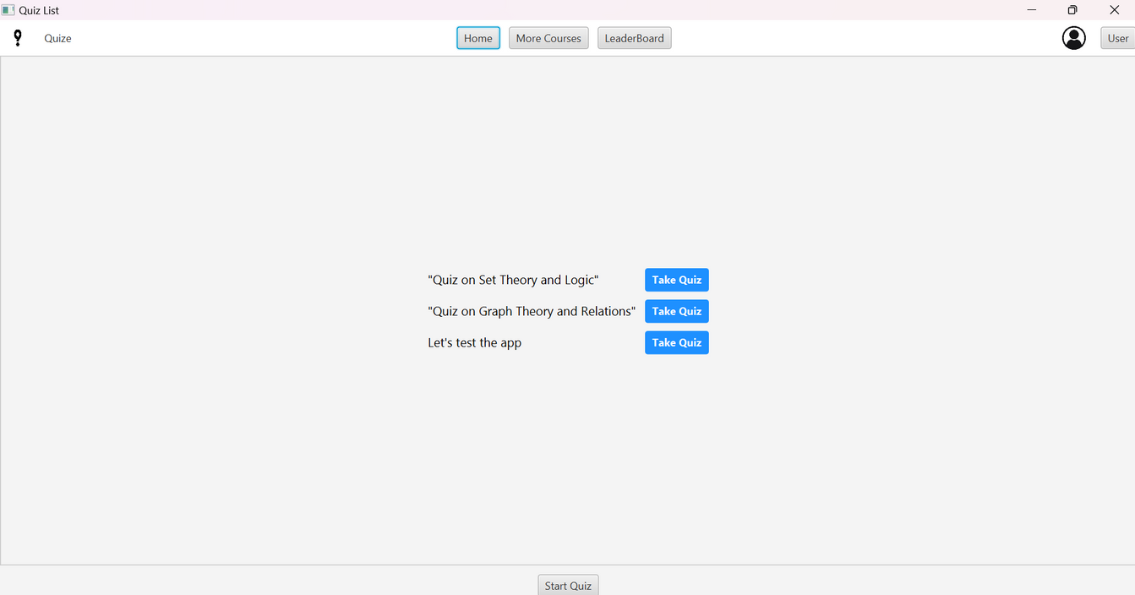
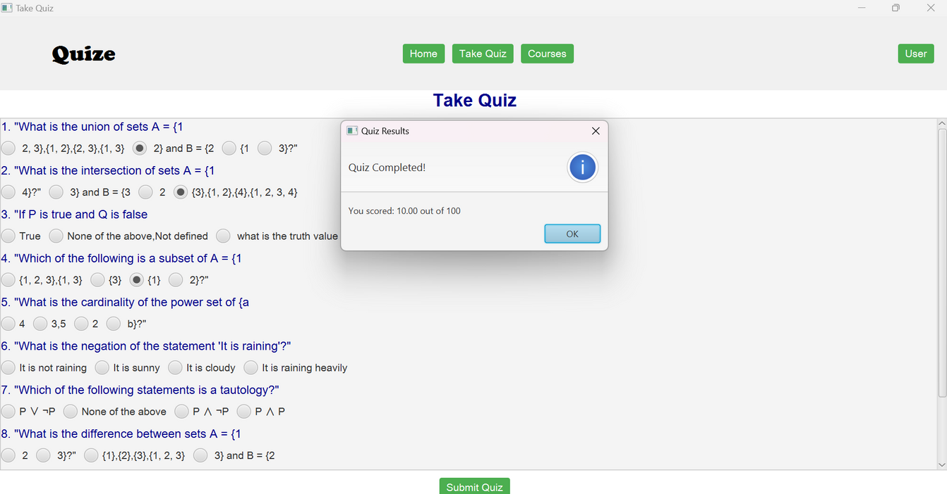
TAKE QUIZ

Slide 7
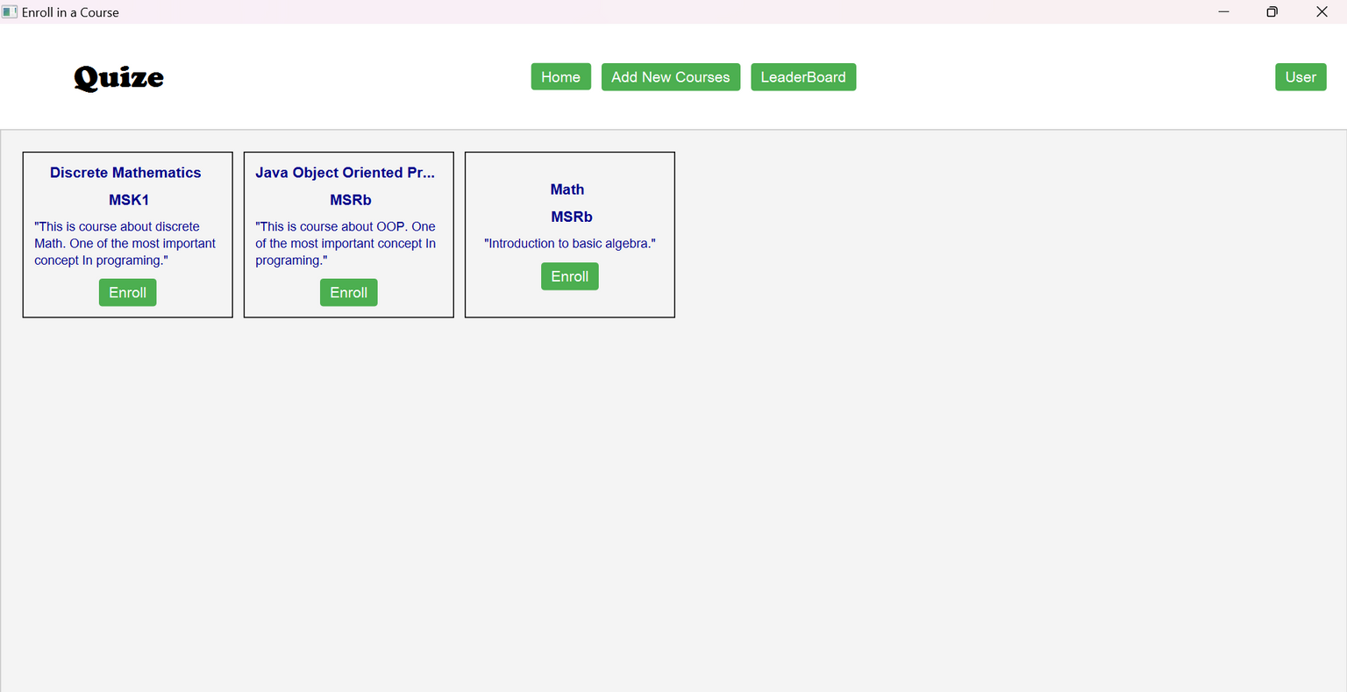
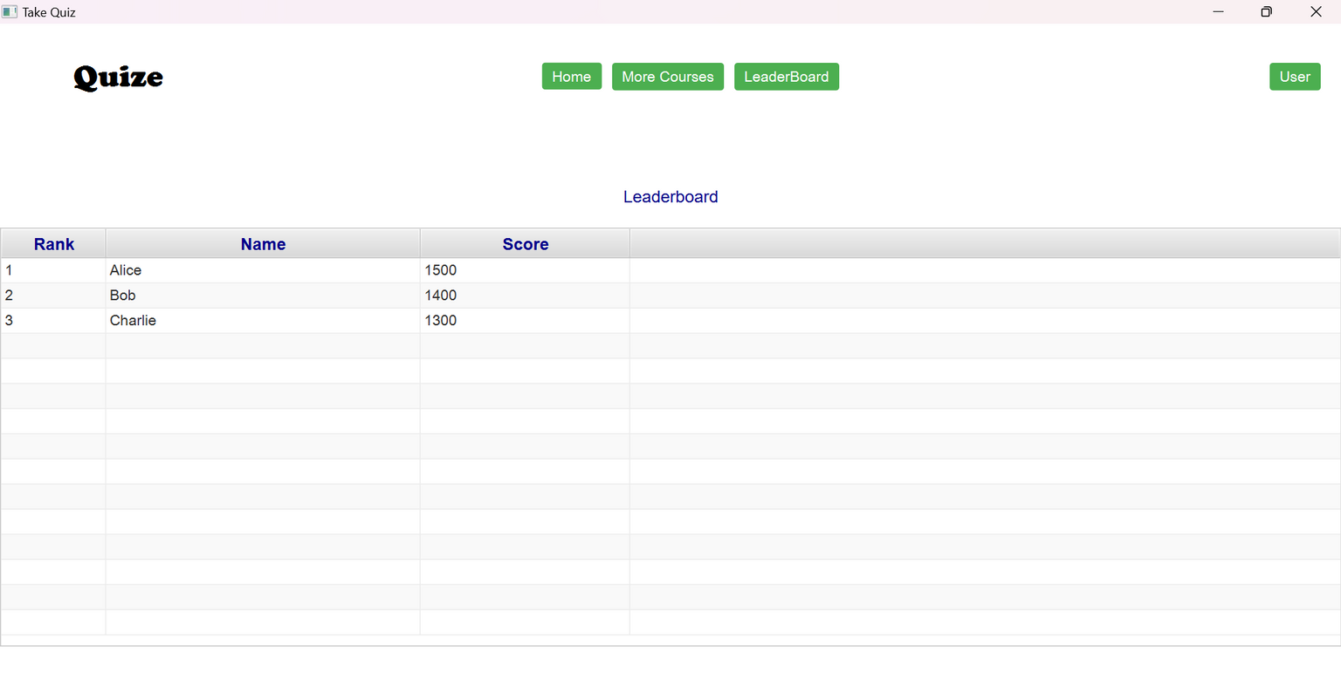
ENROLL & LEADERBOARD

Slide 8
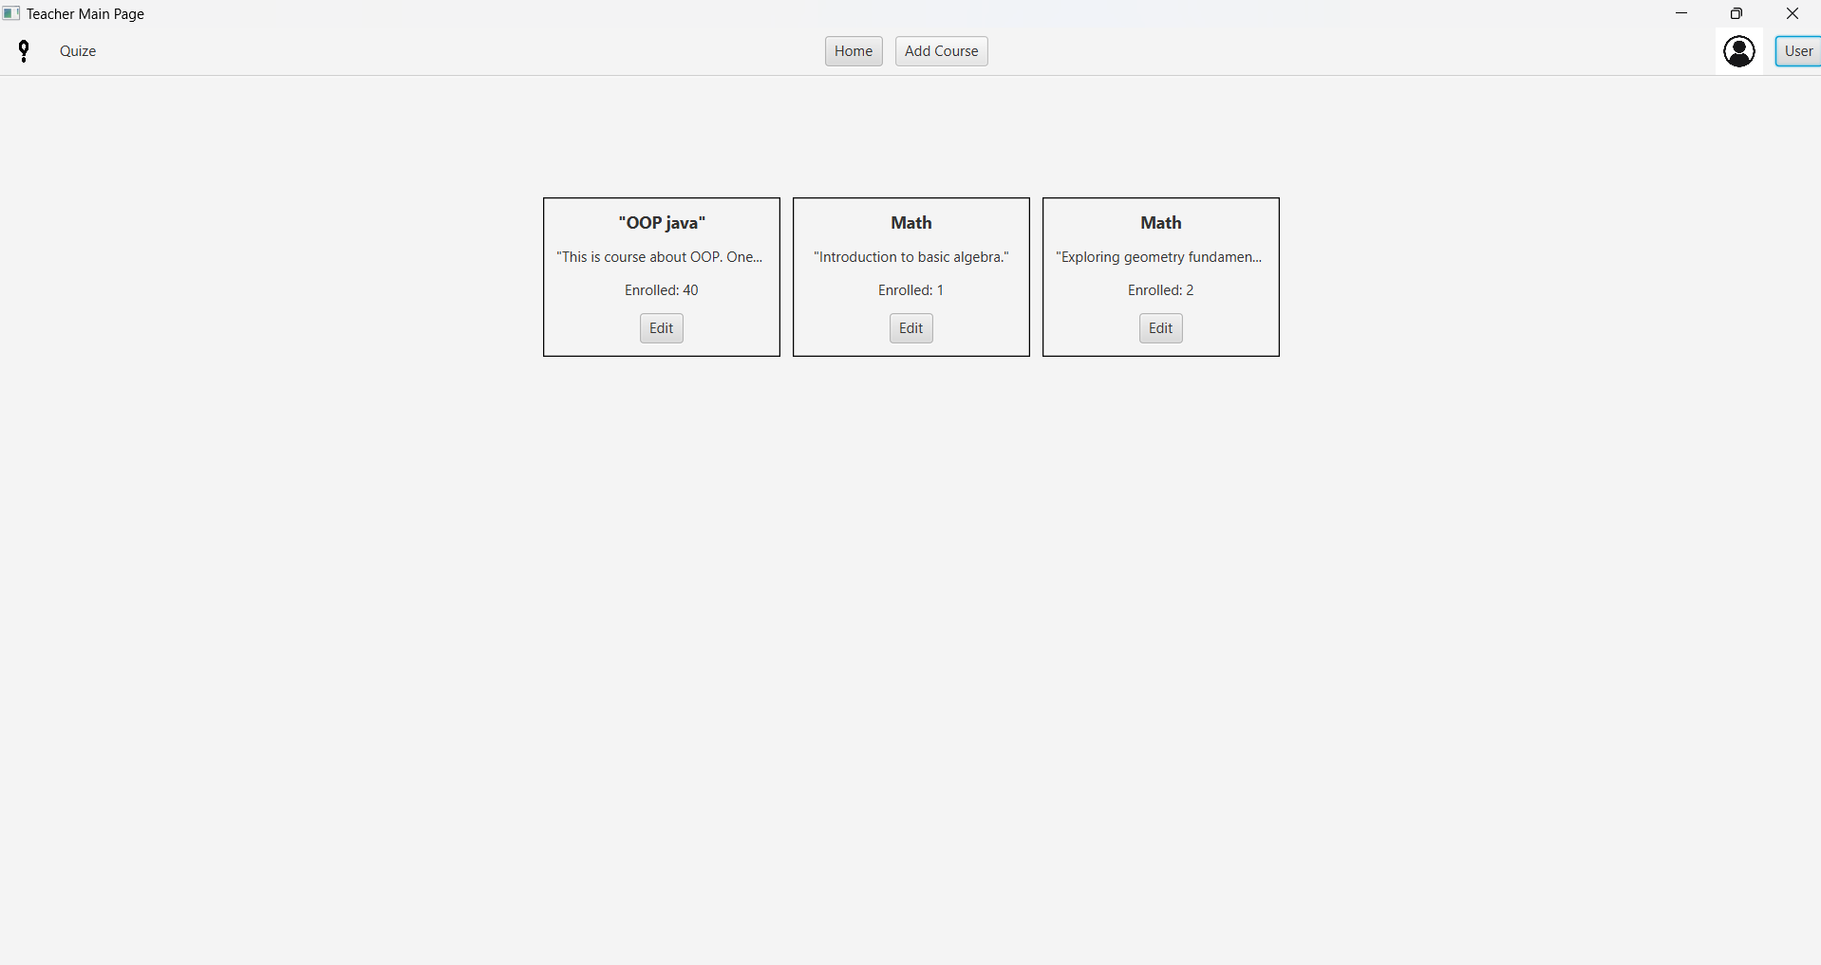
TEACHER MAIN CLASS
TeacherMain Class: Opens the "Add Courses" window and displays the Courses.fxml file for course management.
TeacherMainPage Class: Manages the main page, displays current courses, and supports interaction with course data from CSV files.
AddQuizPage Class: Allows teachers to add new quizzes by generating input fields for questions and saving quiz data to a file.
QuizEditPage Class: Enables editing of existing quizzes, including loading, modifying, and saving quiz data.
UI Integration: Utilizes FXML for binding UI components to Java code, dynamically creating input fields for quizzes and courses.

Slide 9
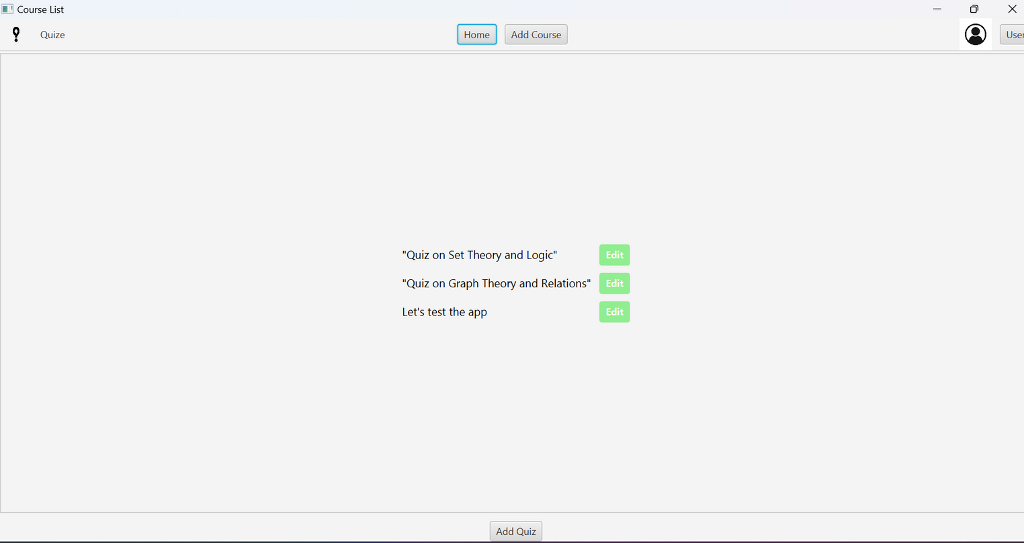
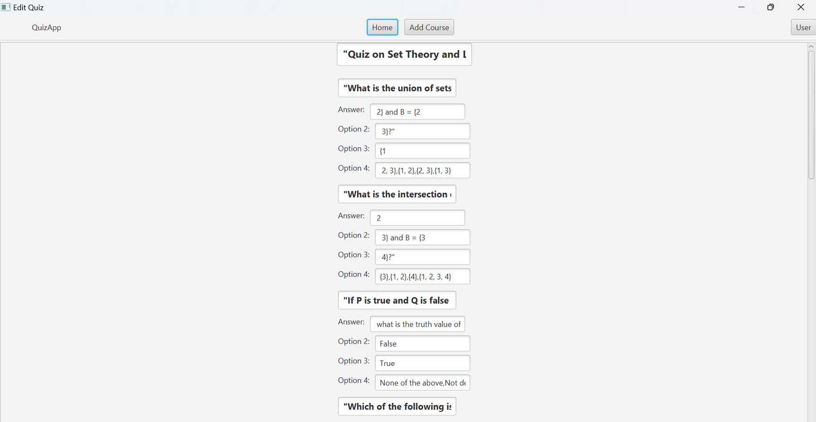
EDIT QUIZ

Slide 10
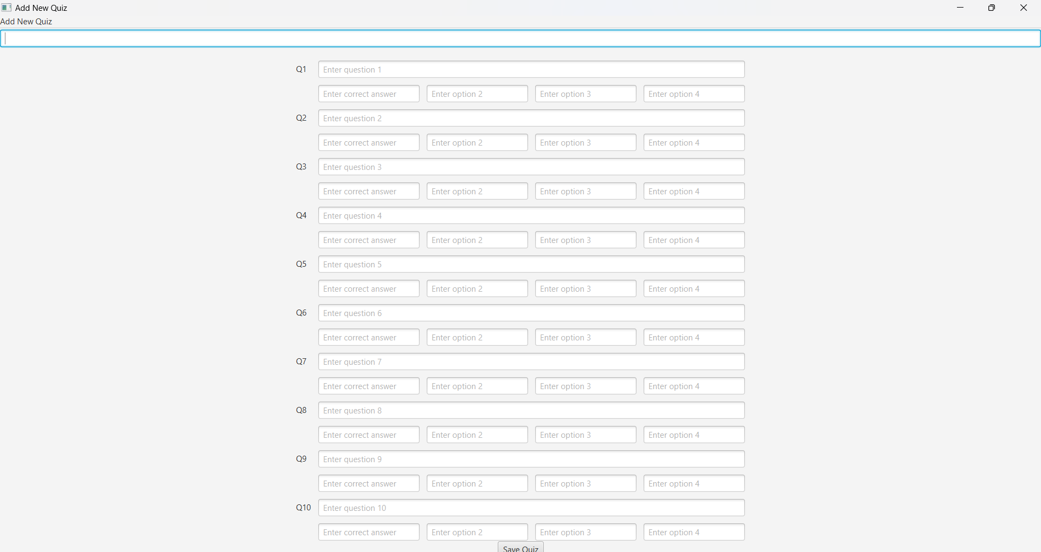
ADD NEW QUIZ

Slide 11
CONCLUSION
The Java Multiplayer Quiz Game provides an engaging experience for players to join quizzes, answer questions, and compete against each other in real time. With a simple and easy-to-use interface, it allows users to sign up, select quizzes, and track their scores. The game supports multiple players, creating a fun and competitive environment. It also handles different roles, such as students and teachers, making it suitable for educational purposes. Overall, the game offers both entertainment and learning, providing a great tool for players to test their knowledge.

Slide 12
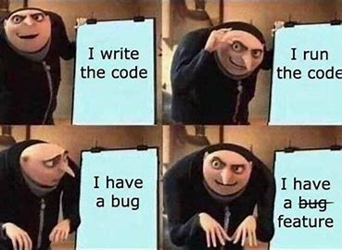


Slide 13
THANK YOU!
Presented by Md. Yasir Arafat, Alvee Ifteshum and Syed Amin Hossain

